Slide 1
By,
Madasu Deepika 19MIA1066 HARINISRI G 19MIA1069
Name of the Course: SOCIAL MEDIA ANALYTICS
Slot: D1+TD1
Type of Project: B

Slide 2
Introduction:
The most used and efficient method of communication in recent times is an application called WhatsApp. WhatsApp chats consists of various kinds of conversations held among group of people where as Twitter is a micro-blogging website that allows people to share and express their views about topics, or post messages.
What does other person feel about us and what is trending is the most frequently self-asked question, Everyone has the curiosity of what other person thinks about the other while having a conversation, judging the other person can’t be done perfectly ,So this project is to providing a way using sentiment analysis between conversation and tweets.

Slide 3
Problem Statement
What other person thinks about the other while having a conversation and how to have a better understanding of WhatsApp chat present in our phones?
How might we help the communication practitioners to get actionable insights from Twitter so that they can create more effective communication that caters to the needs & concerns of general public?

Slide 4
Problem Identification:
In case of WhatsApp, How other person feels towards us while having a conversation is one of the biggest questions even most trained professionals cannot answer it. This paper deals with the creating an automation process for identifying overall sentiment of the individual person. Also the frequency of the messages by each person also affects the person emotion.
In Twitter, to understand the person’s sentiment on a specific product or service, organizations. Every day massive amount of data is generated by social media users which can be used to analyze their opinion about any event, movie, product or politics.

Slide 5
Data Collection:
Dataset is a simple text file that has been extracted from any of the WhatsApp groups or one to one individual chat. More the number of text messages ,the more the accuracy will be in identifying the sentiment.
In twitter, we retrieve latest tweets associated to any keyword of the area. The Search Twitter function is used to extend the final phase of downloading tweets from the timeline. Now this list of tweets are converted into data frame (df). The df data frame is converted into
.csv format file

Slide 6
Timeline :
Review no | Process to be carried out | Deadline planned | Contributors
1 | Problem identification and understanding and formulating the objectives. Extraction of the datasets relating to our objectives Preparing the presentation , abstract and studying the literature survey for Review 1 | 15/12/2022 20/12/2022 4/1/2023 | Harinisri and Deepika
2 | Exploratory data analysis ,data cleaning, data visualization for twitter dataset Preprocessing ,applying the sentimental analysis on twitter dataset and drawing out the inference from it . | 14/1/2023 20/1/2023 | Deepika Harinisri
3 | Exploratory data analysis ,data cleaning, data visualization for WhatsApp ( personal chat vs group chat) dataset Preprocessing ,applying the sentimental analysis on whatsapp dataset and drawing out the inference from it Comparative study on these sentimental analysis and to elaborate how it helps in real time. | 15/2/2023 28/2/2023 1/3/2023 | Harinisri Deepika Harinisri and Deepika

Slide 7
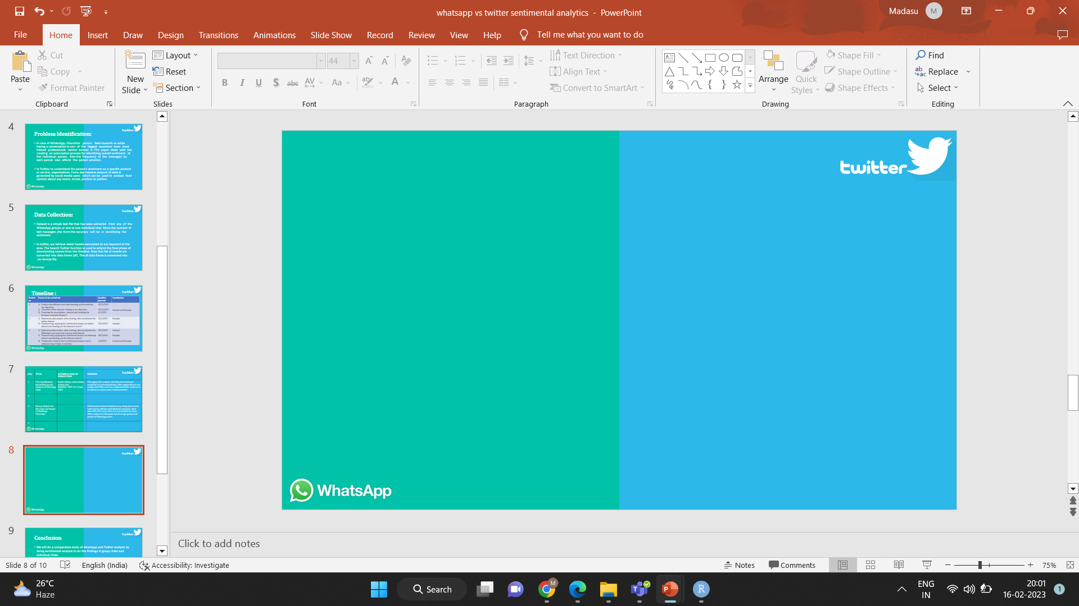
LITERATURE SURVEY
S.No | TITLE | AUTHOR & YEAR OF PUBLICATION | FINDINGS
1 | Text Classification based Behavioural Analysis of WhatsApp Chats | Sonika Dahiya, Astha Mohta, Atishay June 2020 | Throughout the analysis, the behavioral traits are extracted. It is determined that, if the subject likes to use emojis and if they use it as a replacement for words or as an add-on to express their emotions better.
2. | Sentimental analysis on social media data using R programming | Geetha Bhargava Mandava May 2018 | This paper is about the Sentimental Analysis of tweets on topic BARCELONA TERROR ATTACK and classifying views of people in eight different categories of emotion.
3. | Survey Analysis on the usage and Impact of Whatsapp Messenger | Naveen Kumar, Sudhansh Sharma April 2017 | Performed an internet based survey using open-source Lime survey software and obtained responses. More than 63% of its users think it is not harmful for them. Other analyses in this paper based on age-groups and gender of WhatsApp users.
4. | A Comparative Study of Various Approaches for Sentiment Analysis of Twitter Data | Anchal Kathuria, Avinash Sharma January 2016 | This paper provides a comparative of various techniques of opinion mining like Naive Bayes, Machine learning techniques specifically for twitter data.

Slide 8
S.No | TITLE | AUTHOR & YEAR OF PUBLICATION | FINDINGS
5. | Sentiment Analysis of Twitter Data :A Survey of Techniques | Vishal.A.Kharde July 2021 | This paper proposed a technique to carry out the sentiment analysis of twitter data. First, the tweets are aggregated using twitter API. Then the unigram naive bayes model is employed and the features that are not relevant are eliminated using chi square technique and mutual information feature extraction method.
6. | WhatsApp Group Data Analysis with R | Durv Hamp November 2016 | This paper is about the Sentimental Analysis of whatsapp Group and found that the most addicted respondents were in the age group of 20 to30 years representing a young sample.
7. | Sentiment Analysis of Twitter Data in respect of library services. | Naveen Kumar, Sudhansh Sharma April 2017 | Here machine learning technique in which two variations of naive bayes classifier are used. These variations are baseline and binary used for detecting the sentiment of English tweets. The feature vectors used for training set are: lemmas, polarity lexicons and multiwords
8. | A Comparative Study of Various Approaches for Sentiment Analysis of Twitter Data | Anu J Nair, Veena G, Aadithya Vinayak May 2021 | the proposed research work attempts to find the sentiment of tweets using Logistic Regression sentiment analysis, VADER sentiment analysis and BERT sentiment analysis.

Slide 9
Conclusion
We will do a comparative study of whatsapp and Twitter analysis by doing sentimental analysis to do the findings in group chats and individual chats.
That is to analysis the level of participation of the various individuals on the given WhatsApp & Twitter groups and how they analyze customers perspectives toward the critical to success in the marketplace in group chats.

Slide 10
References
(PDF) Sentimental analysis on social media data using R programming (researchgate.net)
https://www.digitalvidya.com/blog/twitter-sentiment-analysis- introduction-and-techniques/
https://medium.com/geekculture/whatsapp-chat-analysis-a-data- view-built-with-streamlit-d7d94525beae
https://www.ijert.org/whatsapp-chat-analyzer

